Slide 1
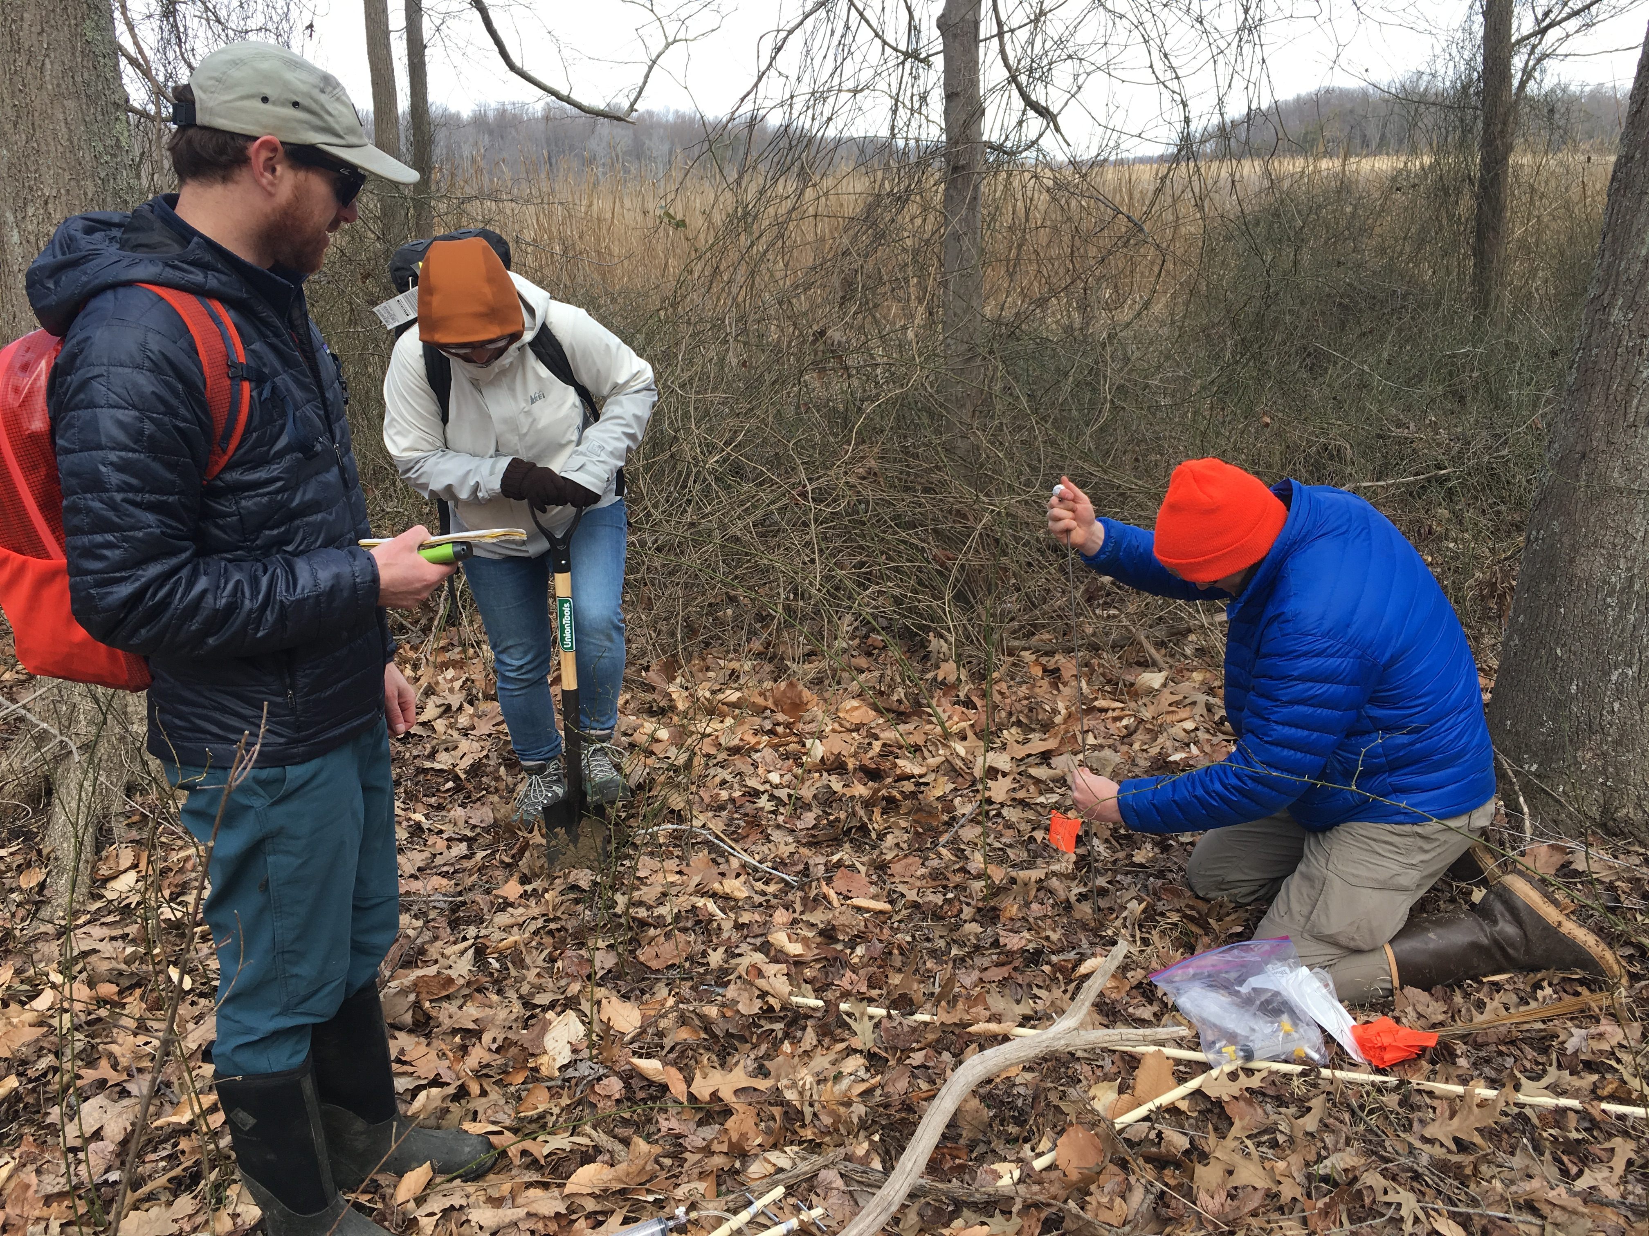
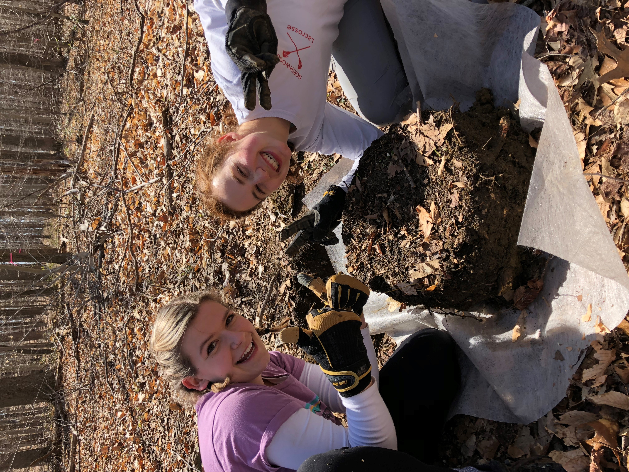
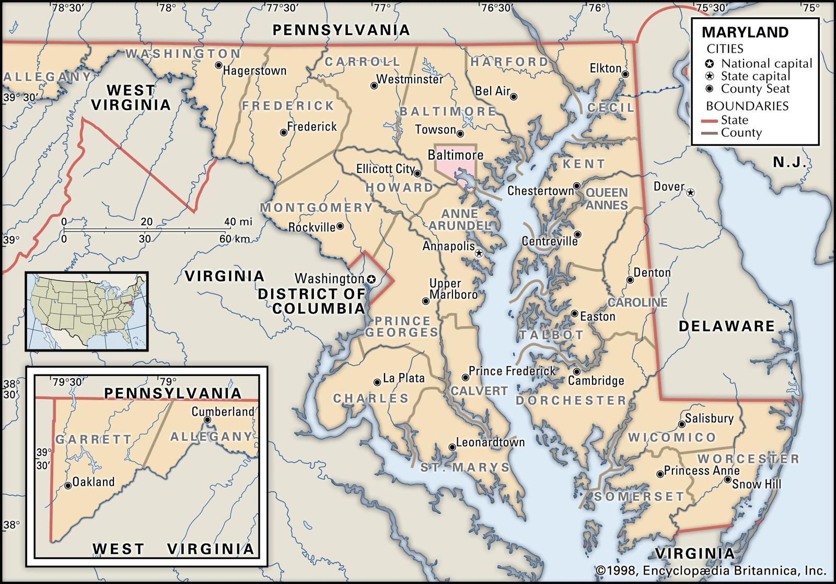
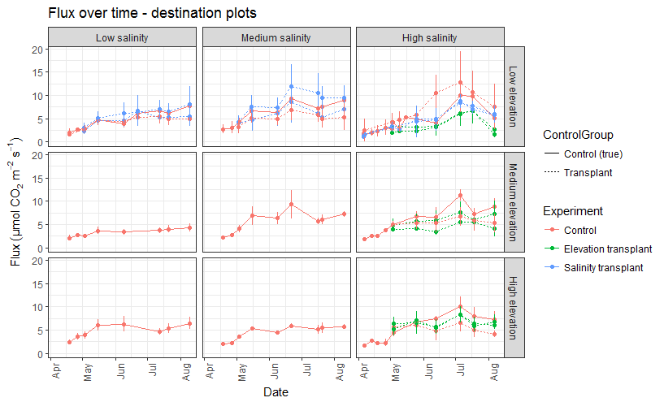
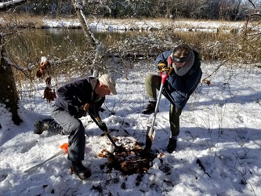
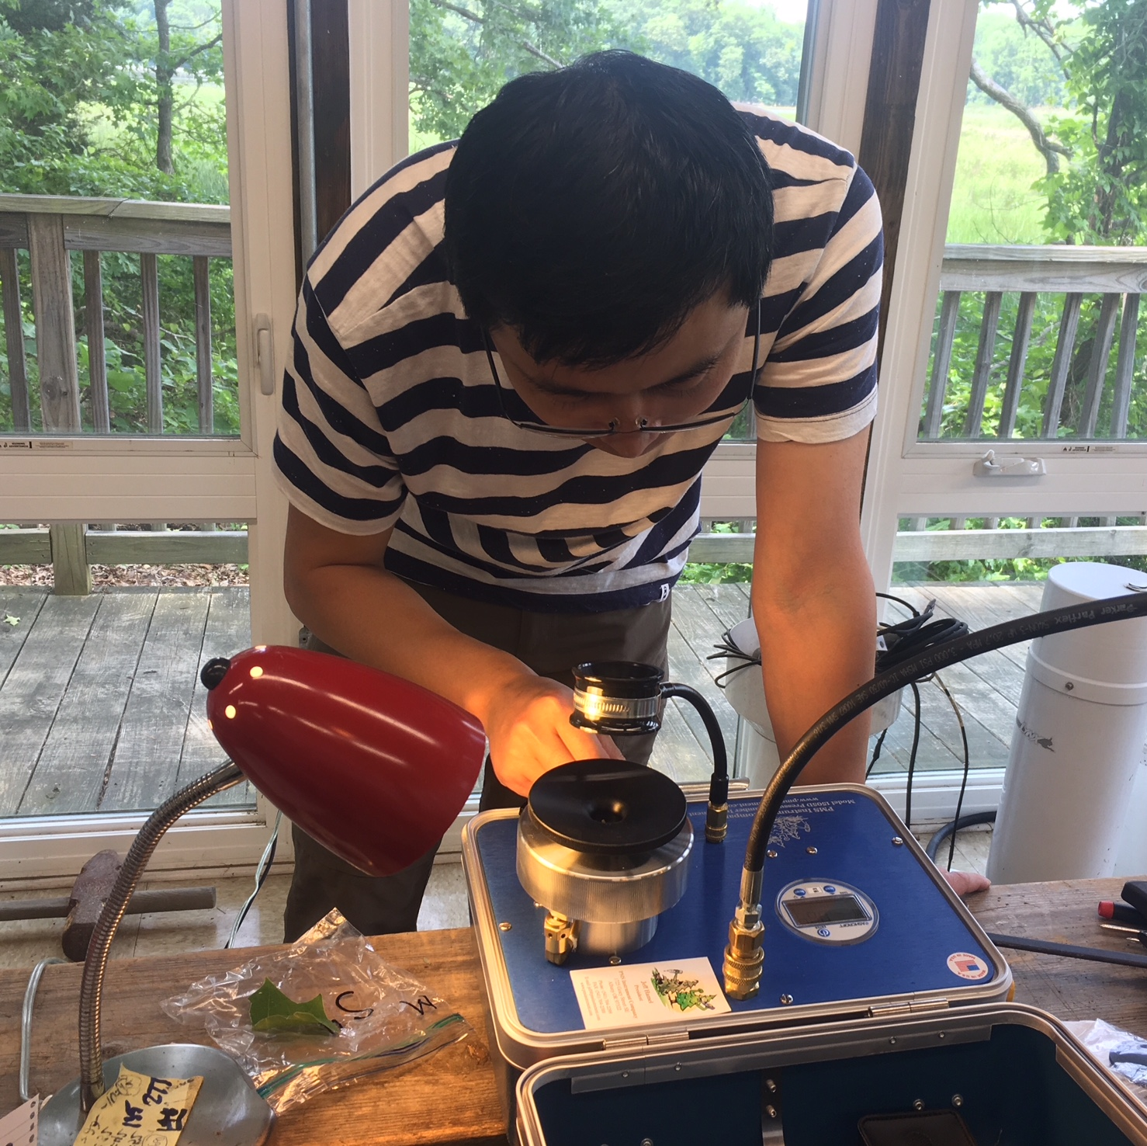
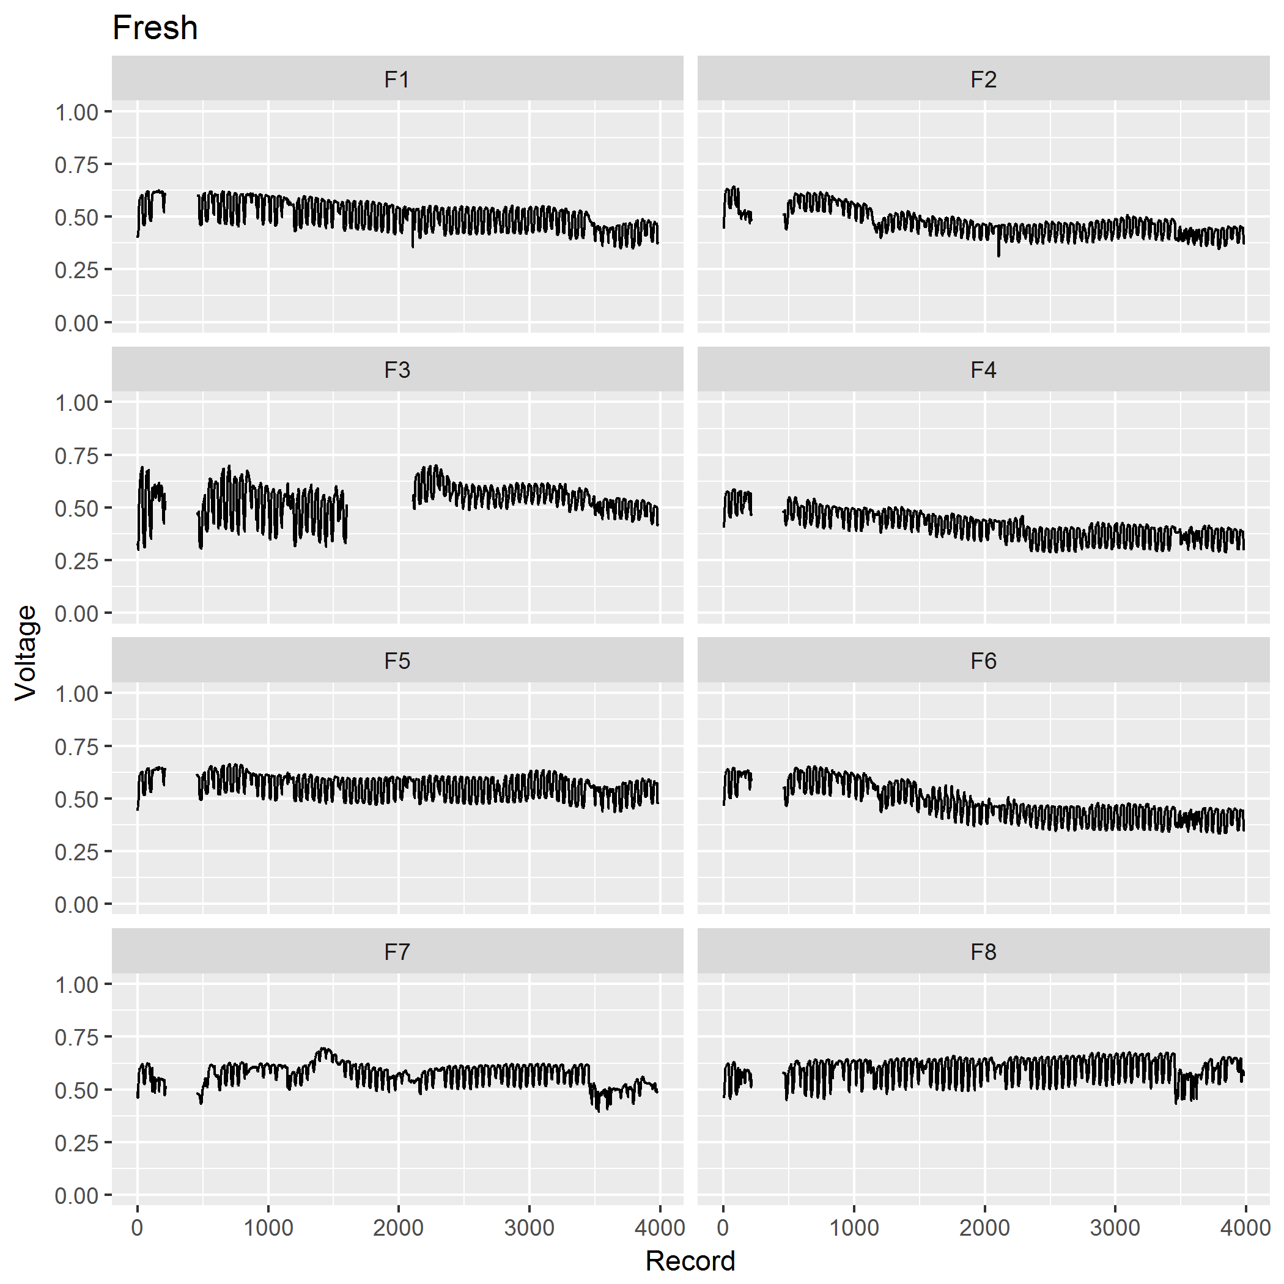
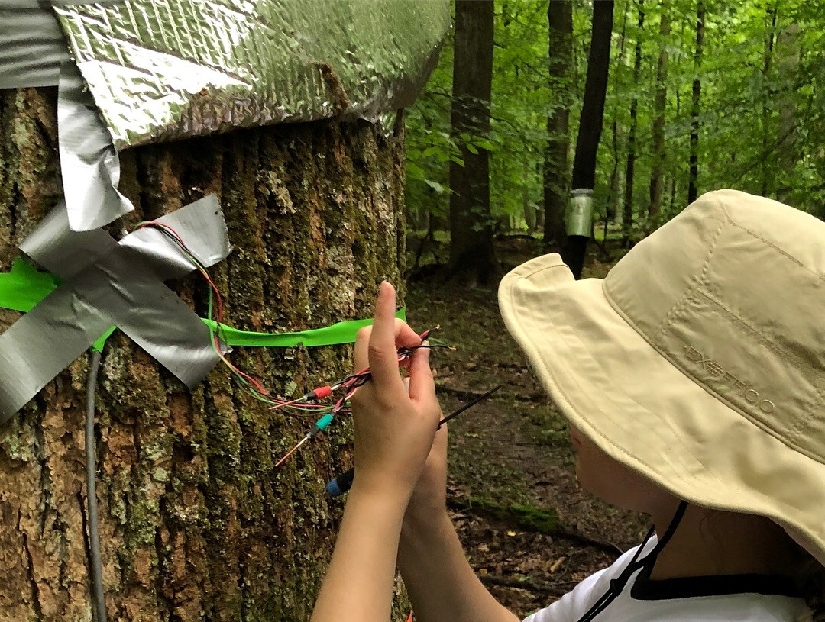
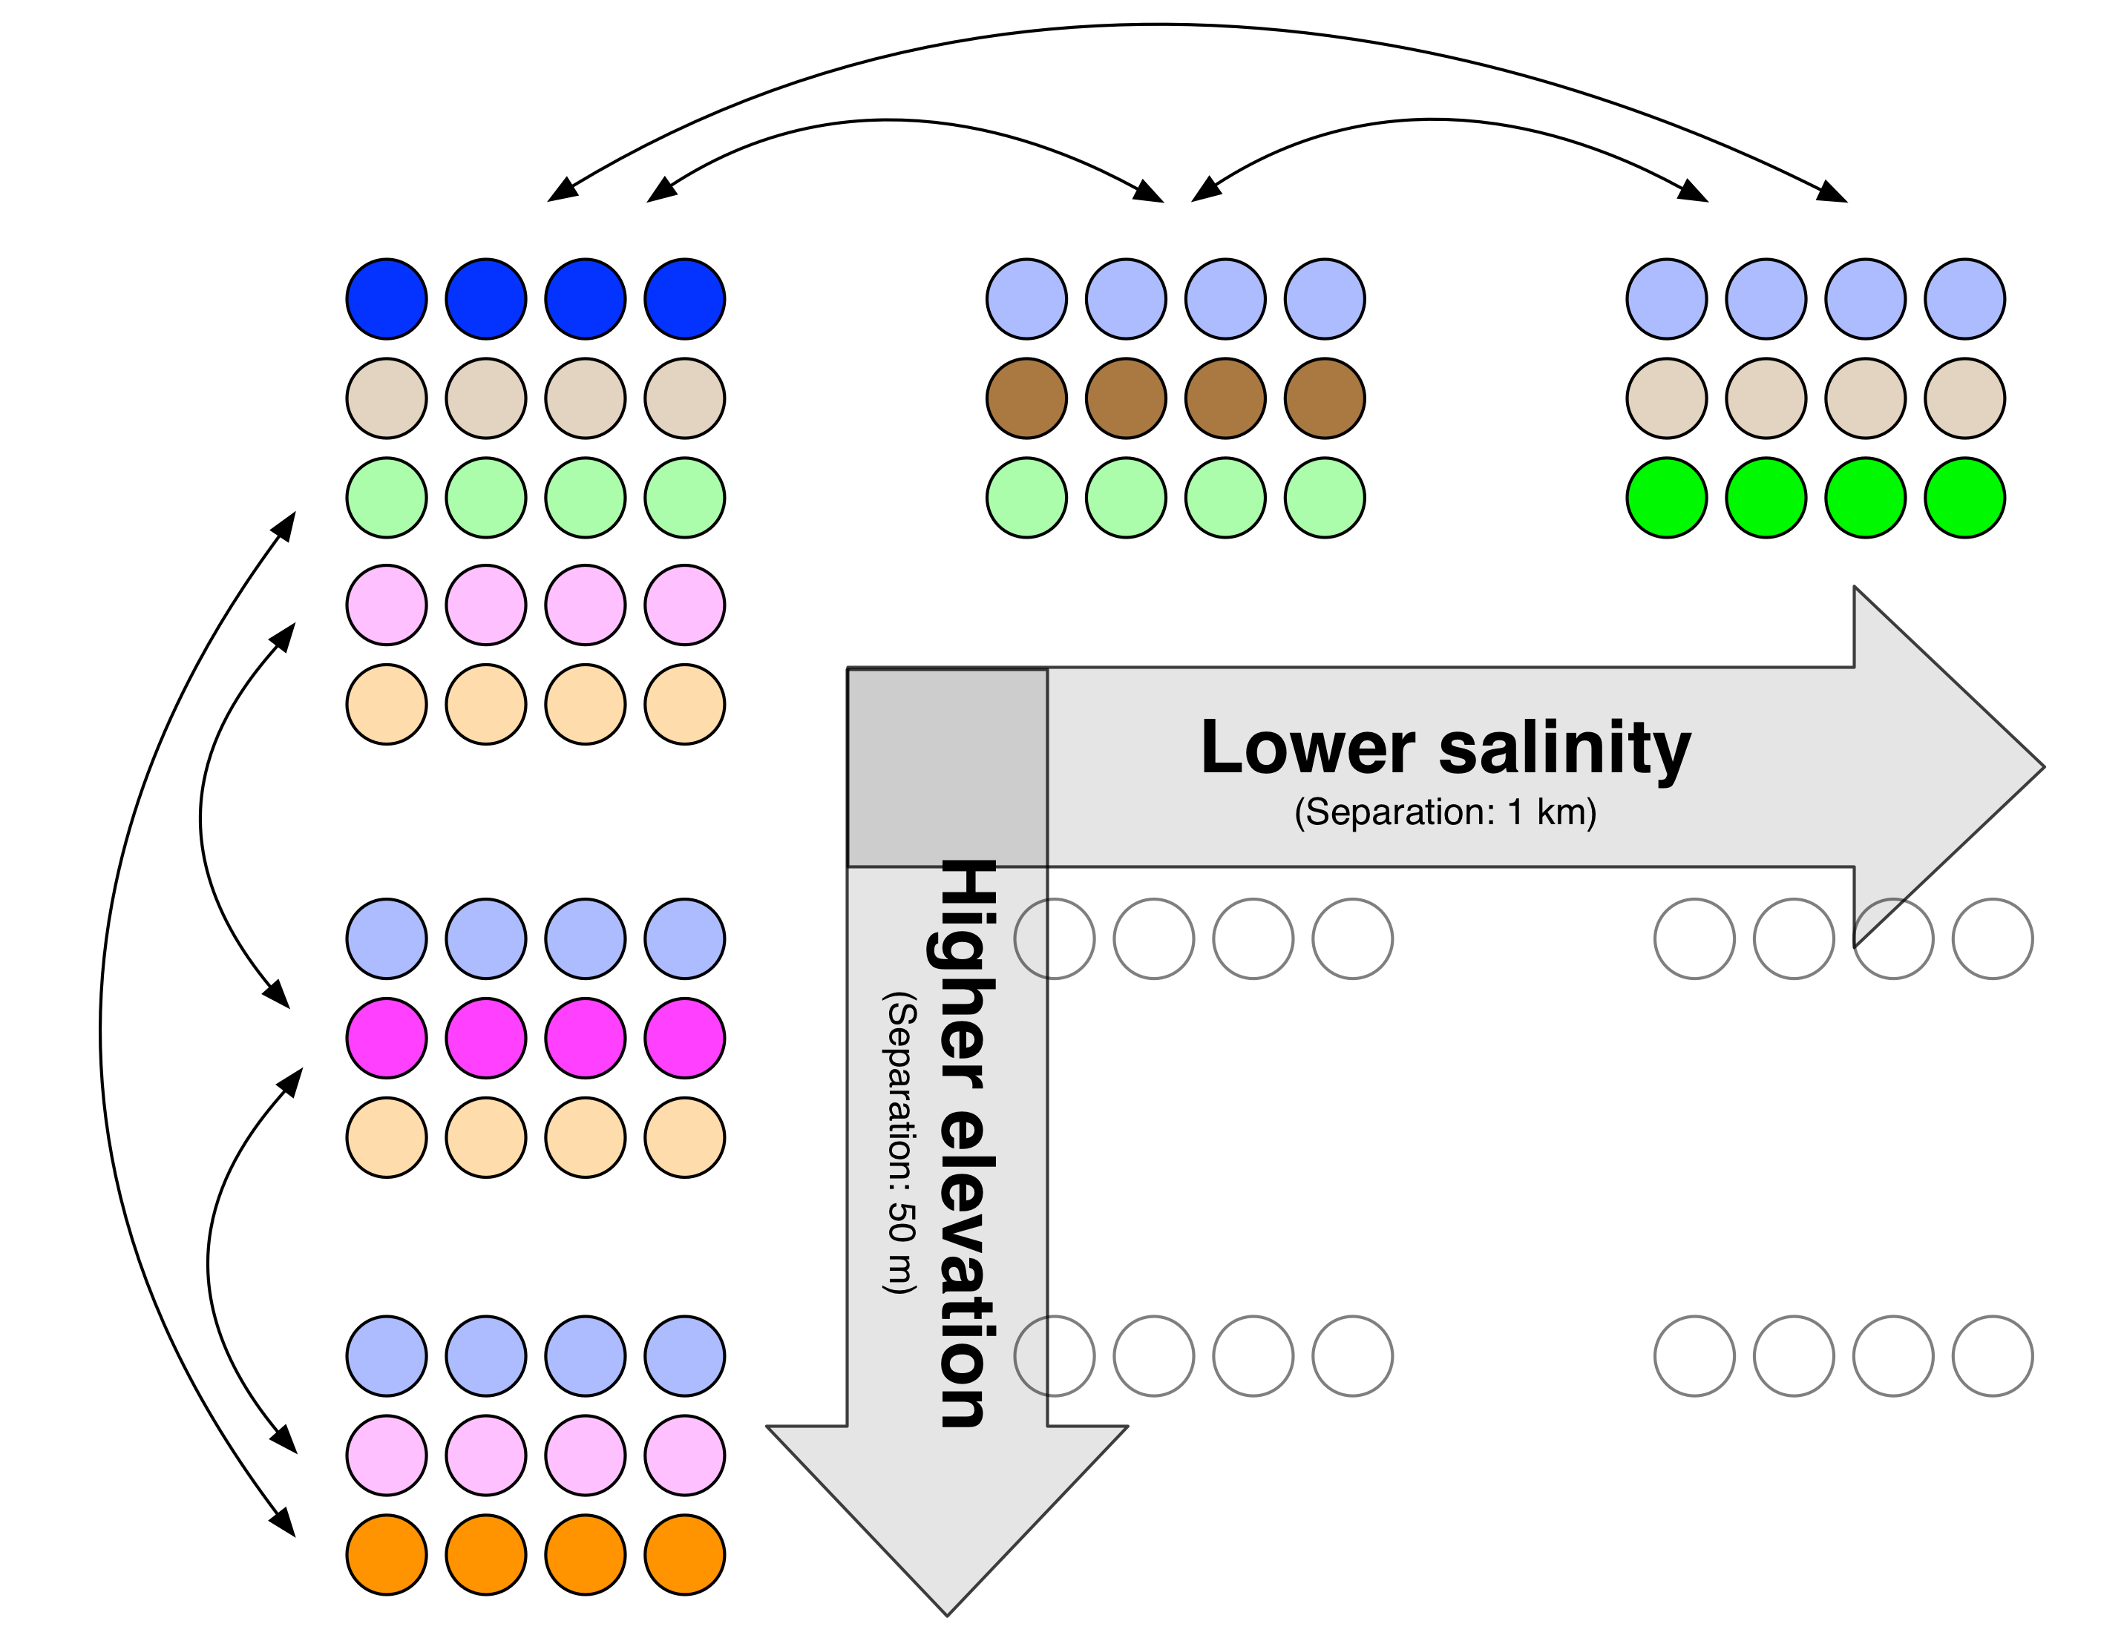
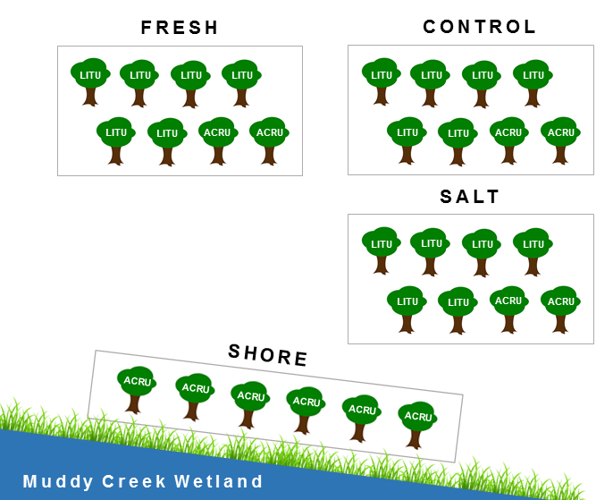
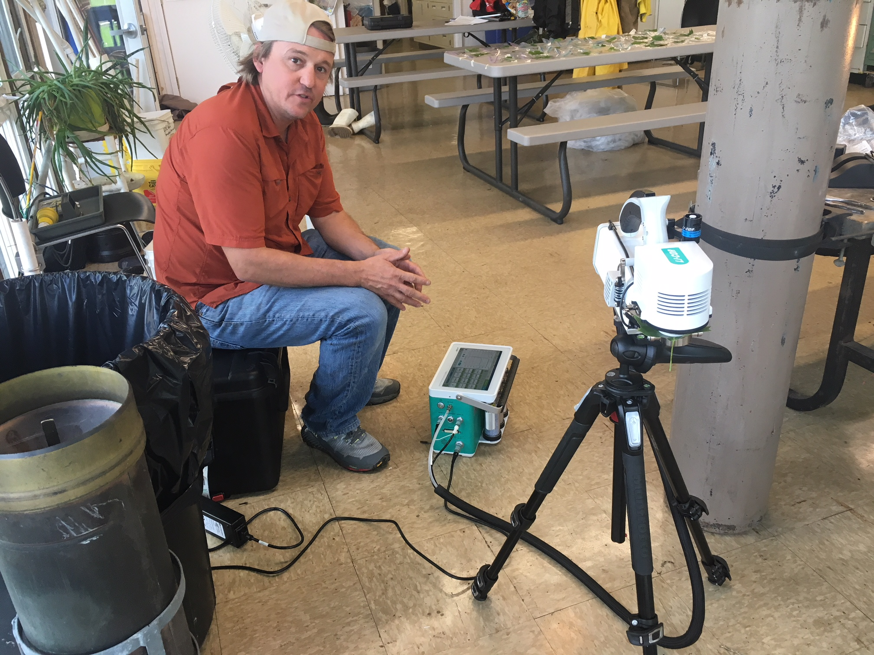
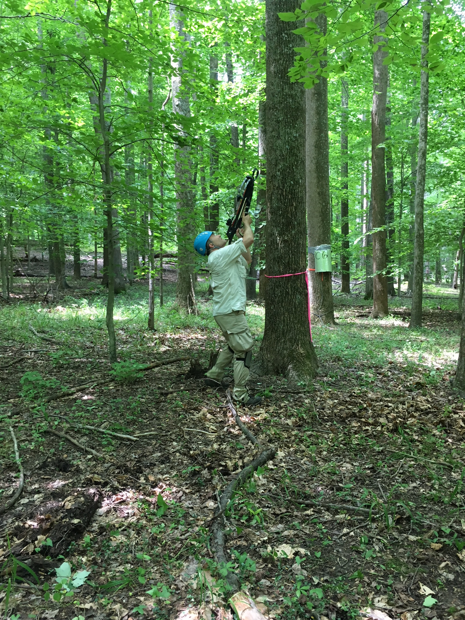


PREMIS: A multidisciplinary approach to understanding the terrestrial-aquatic interface
This project is part of a collaborative effort to understand terrestrial-aquatic interface (TAI) ecosystems stressed by climate change. Monitoring sap flux and greenhouse gas fluxes offers a way to quantify the stability and resilience of terrestrial ecosystems in a changing environment.
MOTIVATION
The TAI may be especially vulnerable to global changes such as sea level rise and extreme weather conditions
Transplanting soil cores allows us to manipulate the environment to simulate environmental changes
Monitoring transpiration in trees via sap flow offers insight into the impact of seawater on plant health
PROGRESS + RESULTS TO DATE
Weather stations installed at each salinity gradient
Wells installed containing conductivity meters
All soil collars installed – measurements taken every 7-10 days
All sap flux sensors installed – measurements taken every 30 minutes
(left to right) Nick Ward (PI), Vanessa Bailey (PI), and James Stegen (PI) sample the soil at GCREW
(left to right) Stephanie Pennington and Mercedes Horn pose with a soil core
Edgewater, MD
APPROACH
LOCATION:
Smithsonian Environmental Research Center – coastal forest on a tributary of Chesapeake Bay in Edgewater, Maryland
DESIGN:
124 transplanted soil cores (40 cm diameter, 20 cm depth) along natural salinity and elevation gradients, including true and disturbance controls
30 trees with Granier-type sap flux sensors
Figure 2. Mean CO₂ flux by sampling date and experiment; error bars show collar-to-collar variability (N=4). Large soil cores were transplanted along a natural salinity gradient (top row) and elevation gradient (right column).
Stephanie Pennington
Ben Bond-Lamberty (PI)
Nate McDowell (PI)
(left to right) Ben Bond-Lamberty (PI) and Stephanie Pennington dig a soil core at SERC
Wenzhi Wang uses a pressure chamber to measure the water potential of a Tulip Poplar leaf
a)
b)
Figure 3. Raw sap flux data (in mV) showing daily variation from May to August, for eight different trees in one of the upland plots.
Stephanie Pennington installs a sap flux sensor in a Tulip Poplar tree
We thank Pat Megonigal and the entire staff of SERC for their support of this research. For more information, please see http://serc.si.edu
FUTURE WORK
Analysis of tree distribution and spatial variability of soil respiration
Quantify sap flow response to saltwater and freshwater treatment
Install continuous soil respiration monitoring system around sap flow trees
Integrated analysis of salinity and disturbance effects on both plant water and soil CO₂ fluxes
Figure 1. a) Transplant design for soil respiration measurements. Pairs of 4 were transplanted across salinity and elevation gradients. b) Graphic of the sap flux design. Fresh, control, and salt plots have sap flux sensors at 6 Tulip and 2 Red Maple trees, and the Shore plot containing 6 Red Maple trees.
Nate McDowell (PI) measures photosynthesis of mid-day leaf samples
https://github.com/PNNL-PREMIS
Uzay Sezen uses a crossbow to gather leaf samples from high canopies
stephanie.pennington@pnnl.gov
Notes:
NOTE: Print this poster file at 100% SCALE to result in a physical print measuring 48” wide x 36” tall. All type size notations shown above are based on the final printed size of the poster.
• Contact Digital Duplicating (375-2969, http://digitalduplicating.pnl.gov) to order poster printing and finishing services for your completed poster design.
• Remember to have your poster cleared for public display/distribution through the ERICA Information Release system (http://erica.pnl.gov).
• Sidebar “About PNNL” box is considered optional, and can be removed if space is needed for technical content.

